Slide 1
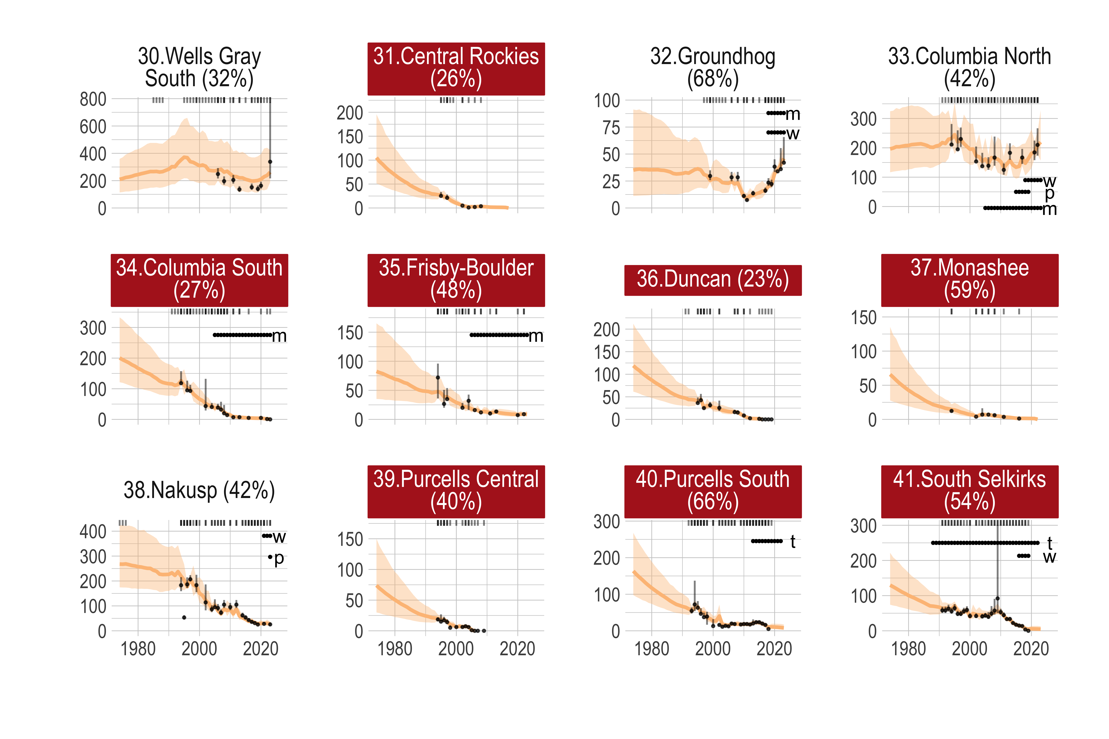
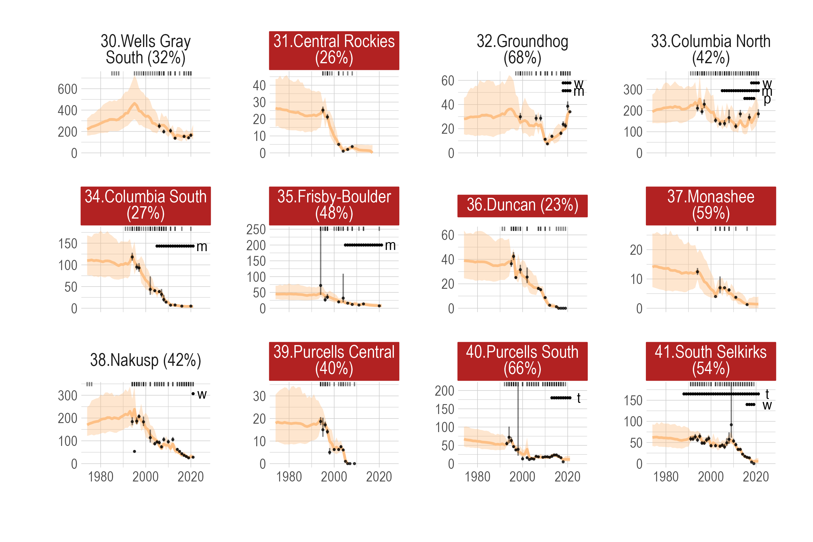
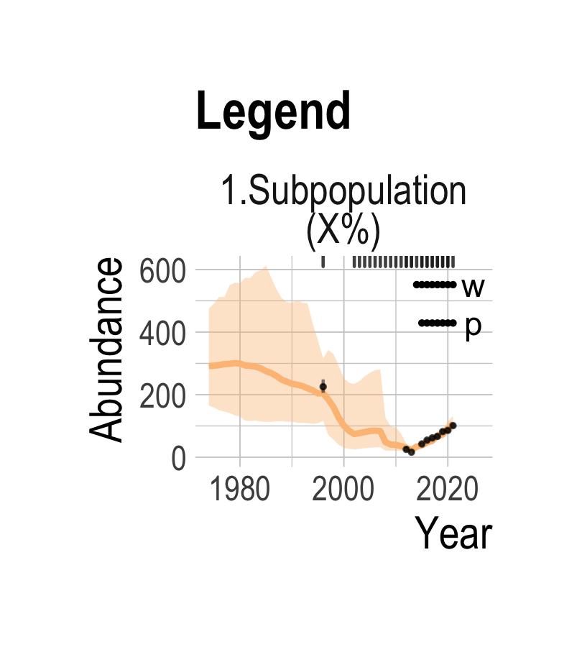
Red filled if functionally extirpated
Label in Fig 1A
% habitat disturbed
Years with data
Recovery measures implemented
w = wolf reduction
t = translocation
m = moose reduction
s = sterilization
p = penning
f = feeding
IPM posterior median and 90% interval
Observed counts

